Slide 1


Slide 2
Object Oriented Programming
Zach Merrill, Systems App Developer - Gallup
James Getrost, Systems App Developer Intern - Gallup

Slide 3
Agenda
Programming Paradigms
Classes and Objects
Inheritance
Polymorphism
Interfaces
Exception Handling

Slide 4
Programming Paradigms
Object Oriented Programming

Slide 5
Programming Paradigms
“A programming paradigm is a fundamental style of computer programming, serving as a way of building the structure and elements of computer programs”
Programming languages provide support for one or many paradigms
There are two main branches
Imperative: describes the what through the how
Declarative: describes the what and not the how

Slide 6
Programming Paradigms
Paradigm | Description | Related | Languages
Procedural | Uses statements for computational state changes and modular procedures | Imperative | C, C++, Python
Functional | Evaluates mathematical functions for computation while avoiding statefulness | Declarative | Python, Scala, Haskell, Lisp
Declarative | Defines logic without defining control flow |  | SQL, CSS
Object Oriented | Represents data structures as objects with attributes and abilities | Procedural, Imperative | Java, C++, C#, Python, Ruby

Slide 7
Classes and Objects
Object Oriented Programming

Slide 8
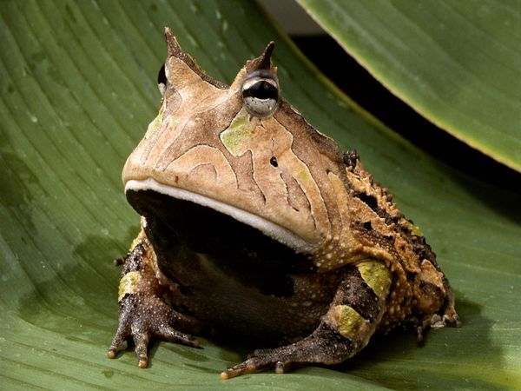
Classes and Objects
OOP allows us to model real-life concepts through classes
Classes have attributes (instance variables) and abilities (methods)
New classes can be defined as needed in Java; this makes a language “extensible”
Amazon Horned Frog
Notes:
Amazon horned frog

Slide 9

Classes and Objects
Classes act as blueprints for objects
Once a class has been written it can be instantiated and used anywhere it is allowed
We can call any methods of an instantiated object and access any of the instance variables
Instance variables can be any object – implies a has-a relationship

Slide 10
Classes and Objects
public class Messanger{
// the private access modifier means
// this variable can only be modified
// internally
private String message = “Hello class!”;
// the public access modifier means that
// anyone who can instantiate this object
// can use it
public void displayMessage(){
System.out.println(message);
}
}

Slide 11
Classes and Objects
public class MessangerRunner{
// main method
public static void main(String[] args){
// instantiate a new Messanger object
Messanger myMessanger = new Messanger();
// calls the displayMessage method. No
// parameters are supplied
myMessanger.displayMessage();
}
}

Slide 12
Classes and Objects
Access modifiers are keywords that define what code can access certain parts of your class
public fields and methods can be accessed from anywhere
private fields and methods can only be accessed from within the class
protected fields and methods can only be used within the same package (more on that later)
Instance variables should almost always be private. This practice is known as data hiding, or encapsulation
These variables can be accessed and modified through public “getter” and “setter” methods if needed

Slide 13
Classes and Objects
Why hide your data?

Slide 14
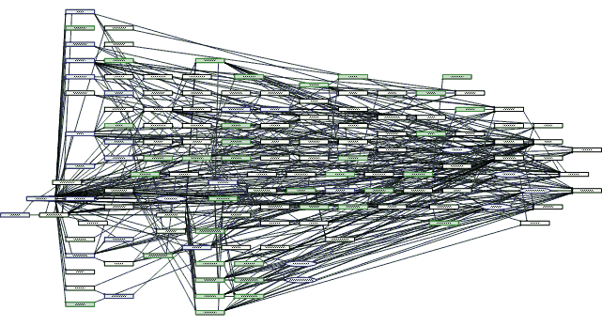
Classes and Objects
Why hide your data?
It is not an issue of security, it is an issue of complexity

Slide 15
Classes and Objects
public class Messanger{
private String message;
public void displayMessage(){
System.out.println(message);
}
public void setMessage(String m){
message = m;
}
public String getMessage(){
return message;
}
}

Slide 16
Classes and Objects
import java.util.Scanner;
public class MessangerRunner{
public static void main(String[] args){
Scanner input = new Scanner(System.in);
Messanger myMessanger = new Messanger();
System.out.println(“What’s the word: “ );
String m = input.nextLine();
myMessager.setMessage(m);
myMessanger.displayMessage();
}
}

Slide 17
Classes and Objects
Constructors are specialized methods that are called when an object is initialized with the new keyword
Every object must have a constructor called when it is initialized
Constructors must have the same name as the class
If a constructor is not defined for a class then the compiler will provide a default at compile time
Objects can be passed into constructors just as with any other method

Slide 18
Classes and Objects
public class Messanger{
private String message;
// constructor initializing message variable
public Messanger(String m){
message = m;
}
public void displayMessage(){
System.out.println(message);
}
…
// getter and setter omitted for space
}

Slide 19
Classes and Objects
import java.util.Scanner;
public class MessangerRunner{
public static void main(String[] args){
Scanner input = new Scanner(System.in);
Messanger myMessanger = new Messanger();
System.out.println(“What’s the word: “ );
String m = input.nextLine();
myMessager.setMessage(m);
myMessanger.displayMessage();
}
}

Slide 20
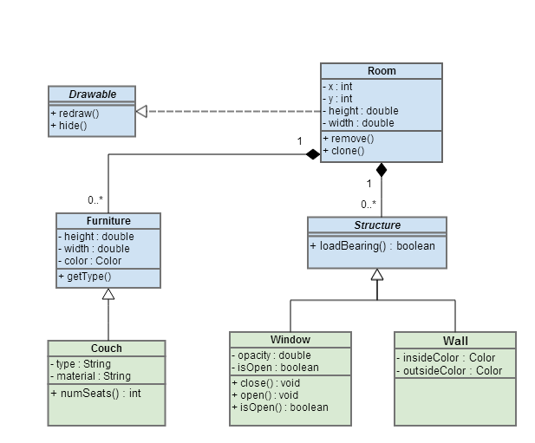
Classes and Objects
The Unified Modeling Language (UML) is a software design standard we use to describe an object oriented system
We will look at a small part, the class diagram

Slide 21
Classes and Objects
Other considerations
Always be aware of a variable’s lifespan, or scope. Variables defined at the class level will exist as long as an object exists. Variables defined at the method level will only exist while that method is executing
Objects that are initialized from the same non-static class are independent from one another
Coding style conventions are very important! Keep your code clean and consistent. It will make your collaborators very happy

Slide 22
Inheritance
Object Oriented Programming

Slide 23
Inheritance
A key feature of object oriented languages is the ability to derive classes from existing classes
The derived classes, also known as subclasses, inherit the fields and methods of the parent class, also known as superclasses.
This is known as the is-a relationship
Defined using the extends keyword

Slide 24
Inheritance
All classes inherit either directly or indirectly from the Object class
Object provides the most basic functionality
equals(Object obj)
hashCode()
notify() & notifyAll()
toString()
wait()
clone()
finalize()
getClass()
These classes form a structure known as the Java Platform Class Hierarchy

Slide 25
Inheritance
What can we do?
Access all public and protected fields
Declare new fields
Use inherited public and protected methods
Override inherited public and protected methods
Write new methods
Invoke the superclass constructor using the super() call
What can’t we do?
Access private fields
Use private methods
What shouldn’t we do?
Hide fields and methods by using the same name and signature without overriding

Slide 26
Inheritance
Is this code allowed?
Object obj = new Frog();
What about this code?
Frog myFrog = obj;

Slide 27
Inheritance
Frog is an object because it will automatically subclass
An object might be a frog, but the compiler has no way of inferring that from the code written
We must tell the compiler that the object is a frog by casting it
Frog myFrog = (Frog)obj;

Slide 28
Inheritance
What if that object is not a frog?

Slide 29
Inheritance
What if that object is not a frog?
Runtime error!
if (obj instanceof Frog){
Frog myFrog = (Frog)obj;
}

Slide 30
Inheritance
Code time! We are going to set up a framework for a simple HR department
Our company has 3 types of employees: executives, managers and hourlies
All employees will have a first name, last name and employee id
Executives and managers have salaries and hourly employees have a wage and hours worked
All employees will have a calculate pay method
Executives have a salary multiplied by a company performance coefficient divided into 24 pay periods
Managers have a salary divided into 24 pay periods
Hourlies multiply hours worked by wage

Slide 31
Inheritance
Our Employee class could have been declared as abstract
Abstract classes may never be instantiated, they are intended to be subclassed only
Abstract classes can include abstract methods, which are not implemented until they are subclassed
This is a good way to guarantee closely related classes will reuse code

Slide 32
PolyMorphism
Object Oriented Programming

Slide 33
polymorphism
Polymorphism is the design principle of using a common interface to represent the concrete implementation
When a class inherits the method from a superclass, it can override the functionality, but it must retain the same signature!
The JVM can call the appropriate method for each object, even when it has been cast. This is known as virtual method invocation
Take a look at our employee example

Slide 34
Interfaces
Object Oriented Programming

Slide 35
interfaces
Cannot be instantiated directly
Cannot have variables
Purely a definition of method functionality
Main benefit is multiple inheritance
Provide a can-do relationship
Defined using the implements keyword

Slide 36
interfaces
Lets rewrite our employee example using a Payable interface class

Slide 37
interfaces
Interfaces take advantage of polymorphism too
We cannot directly instantiate (with the new keyword), but we are able to cast
This allows us to group otherwise unrelated objects by the shared functionality

Slide 38
Exception Handling
Object Oriented Programming

Slide 39
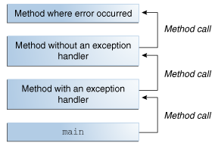
Exception Handling
“An exception is an event, which occurs during the execution of a program, that disrupts the normal flow of the program’s instructions”
Java exceptions are objects created when an error occurs and passed to an internal handler
Contains a call stack, or list of methods executing when the error occured

Slide 40
Exception Handling
Java defines 3 types of exceptions
Checked exceptions (FileNotFoundException)
Errors (IOError)
Runtime exception (NullPointerException)
Of these, only checked exceptions are required by the compiler to be handled

Slide 41
Exception Handling
There are 3 keyword blocks we use sequentially to catch exceptions
try: this contains the code to be executed that might throw an exception
catch: here we specify one or many of the exceptions that could be thrown, and what to do if they are encountered
finally: this block will always be executed after the try block regardless of exceptions. Typically this is used to close file inputs

Slide 42
Exception Handling
Oracle Example:
public void writeList() {
PrintWriter out = null;
try {
System.out.println("Entering" + " try statement");
out = new PrintWriter(new FileWriter("OutFile.txt"));
for (int i = 0; i < SIZE; i++) {
out.println("Value at: " + i + " = " + list.get(i)); }
} catch (IndexOutOfBoundsException e) {
System.err.println("Caught IndexOutOfBoundsException”)
} catch (IOException e) {
System.err.println("Caught IOException: " + e.getMessage()); } finally {
if (out != null) {
System.out.println("Closing PrintWriter");
out.close();
} else {
System.out.println("PrintWriter not open");
}
}
}

Slide 43
Exception Handling
We can also define methods that throw exceptions for later methods to catch
public void writeList() throws IOException, IndexOutOfBoundsException {
…
}

Slide 44
Summary
Programming Paradigms
Classes and Objects
Inheritance
Polymorphism
Interfaces
Exception Handling

